Slide 1
ANDROID LOLLIPOP
All about Lollipop that you cannot do in KitKat
-Supada Hegde

Slide 2
INTRODUCTION
All right -- you've heard all about Google's Android 5.0 Lollipop release. You've read the reviews. Now what should you do once you actually get your hands on the software?
Get to know the best version of Android yet by working through this selection of tips and tricks, covering all of the new features, major and minor, that are built into the operating system.
One of the most prominent changes in the Lollipop release is a redesigned user interface built around a design language referred to as "material design".

Slide 3

TAP AND GO
When you're setting up your new Lollipop device for the first time, you'll be presented with the option to "tap and go." This NFC-and-Bluetooth-powered data transfer lets you move all of your Google Account details, configuration settings, data and apps over to a new device just by placing your old phone or tablet against it. Widgets and wallpaper are swapped over as well.

Slide 4
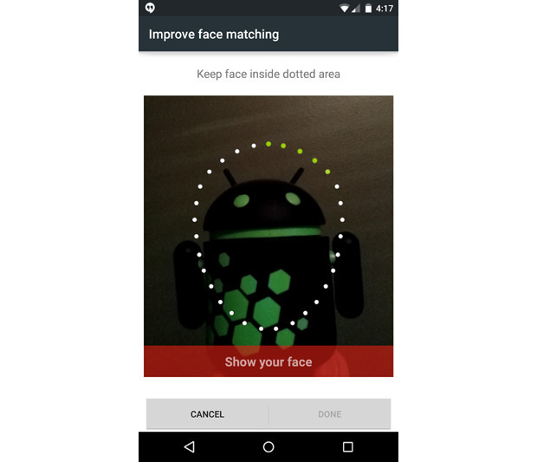
FACE LOCK
While you're in that same "Security" menu, go back into "Smart Lock" and tap "Trusted face." Follow the prompts to train the system to recognize your face, then press the power button and give it a whirl.

Slide 5
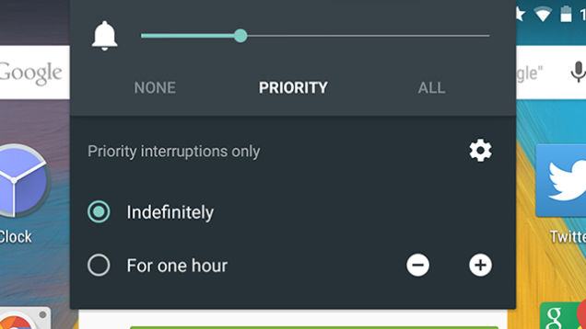
PRIORITIZE YOUR APPS
Android 5.0 Lollipop lets you set up a list of important apps that are allowed to disturb you even when most aren't. Head to Settings -> Sound & notification -> App notifications and you can choose to block each app or mark it as a priority one. Tap the volume slider on your device to activate priority mode indefinitely or for one hour (a star will appear in the status bar).

Slide 6
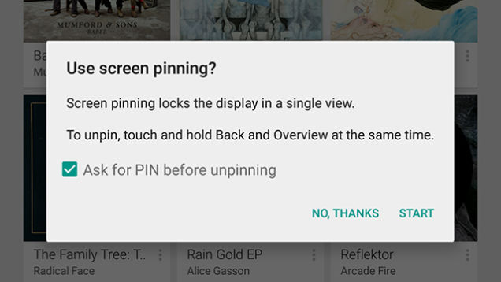
PIN APPS
If you want to hand over your device to one of your kids or a friend, you can "pin" them inside one single app. First, activate the feature via Settings -> Security -> Screen pinning. Then, when you activate the multitasking screen via the square Overview button, you'll see a pin icon appear in the lower right-hand corner of the bottom app (drag it up if you can't see it).

Slide 7
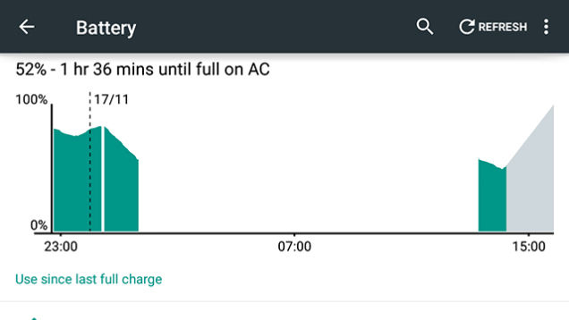
BATTERY LIFE PREDICTION
New to Android 5.0 Lollipop is the ability to see how much time is left before the battery runs out of juice, or how long you need to wait before your device is fully charged up. Tap on the battery icon in the notification drawer to see either reading (the time-until-charged information also appears on the lock screen a few minutes after you've connected your device to a power source).

Slide 8
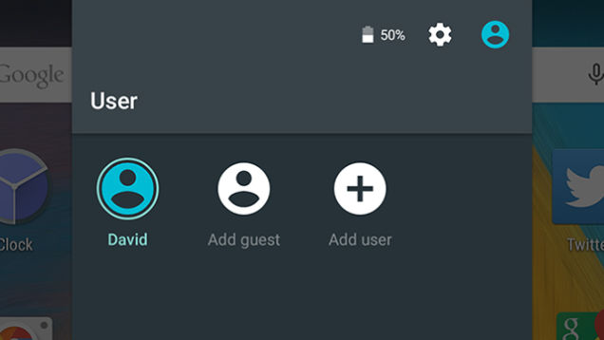
ENTER GUEST MODE
Sharing devices with other people (friends, colleagues, family members, distracted children) can be a real pain, but Lollipop's new Guest Mode eases it somewhat. You can access Guest Mode by dragging down the notification drawer, tapping on your user account avatar, and then selecting Add guest from the menu (or just Guest if you've been through the process before).

Slide 9
TEXT LEGIBILITY
If you were wondering if the Accessibility menu within Settings would get overlooked in the Android 5.0 upgrade, there's a new experimental feature here called High contrast text. Essentially, it gives white or difficult-to-read text a black outline when it's being viewed on a light background. It's applied to the "OK Google" text inside the home screen search bar, for example.

Slide 10
FAST CHROMECAST
There's an official Chromecast app from Google that lets you screencast from any device running Android 4.4.2 or higher, but the functionality is built right into Android 5.0, which is great news for anyone with one of the compact streaming dongles to hand. It's right in the notification drawer—tap on the Cast screen icon to locate your Chromecast and begin screencasting.

Slide 11
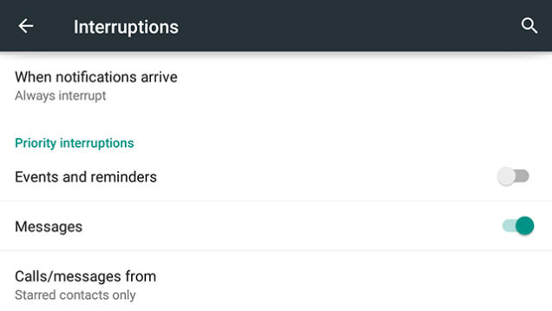
HANG A ‘DO NOT DISTURB’ SIGN
This works a little bit like the priority app notifications we mentioned earlier, but it's based around times and days more than apps. Go to Settings -> Sound & notification -> Interruptions to set it up—it's perhaps best used overnight when you don't want to be disturbed, but there is the option to let certain contacts through as well as messages and alarms, if necessary.

Slide 12
GET BACK APPS AFTER REBOOT
If you reboot your device in any version of Android before 5.0, all of your recently opened apps will disappear. In Lollipop, they're still present on the Overview screen, so you can quickly get back to a previous conversation or website if you need to (not all apps will remember exactly where you were in the app). To remove a card from the list, swipe it away to the left or right.

Slide 13
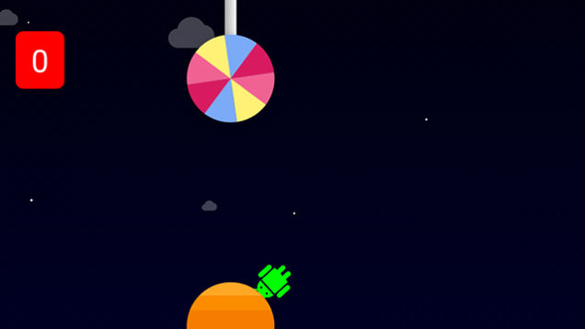
PLAY GOOGLE FLAPPY BIRD CLONE
Like earlier versions of Android, Lollipop has an Easter egg to unlock. Go to Settings -> About phone then tap quickly four times on the Android version entry. Once the Lollipop graphic appears, tap quickly on it several times then finish with a long press to launch a clone of Flappy Bird with an Android robot in place of the bird. It's just as frustrating to play as the original too.

